Slide 1

231133 - Marco Giarrusso
293028 - Fabio Paolantonio
RealEstate Ads
SOA System
Service Oriented Software Engineering - A DISIM course
Prof. Marco Autili

Slide 2
Introduction
Why SOA?
System goals
Components
Roadmap
UseCases
Scenario PublishAd
Scenario ApproveAd
Getting Started
Resources

Slide 3

RealEstateAds SOA System
Introduction
RealEstateAds is a Service-Oriented Architecture (SOA) system that provides a platform for users to publish and search for ads related to flats, villas, and more.
The system, based on a microservices architecture, is designed to be scalable, modular, and extensible, allowing for the seamless integration of new services and features.

Slide 4
Why SoA and Microservices?

Slide 5
Maintainability
Motivations for the SOA and Microservices Approach
Dividing the system into independent microservices simplifies management. Each service can be maintained separately, reducing the risk of negative impacts on the overall system
Scalability
The ability to instantiate multiple system nodes allows for easy scaling of resources based on demand.
In a real estate platform with a high volume of listings and user interactions, this flexibility is crucial for ensuring optimal performance and service continuity
Reliability
A microservices-based architecture isolates failures, preventing a problem in a single component from compromising the entire system. This approach significantly enhances the system's reliability and resilience
Flexibility
Using SOA and microservices facilitates integration with other systems and the implementation of new features without having to rewrite the entire codebase, speeding up development and deployment times.
The RealEstate Ads SOA System thus represents a cutting-edge solution for real estate management, capable of addressing modern challenges with efficiency and robustness.

Slide 6



Provide a platform for users to publish real estate ads paying a fee.
Provide a platform to search ads based on geolocation, title, and price.
System
Goals
Allow users to create accounts, manage their ads, manage their wallet and charge them for ad publication.
Provide a web frontend interface for users to interact with the system.
Ensure system interoperability and integration through REST and SOAP services.
Ensure system security and data privacy through JWT token-based authentication.

Slide 7
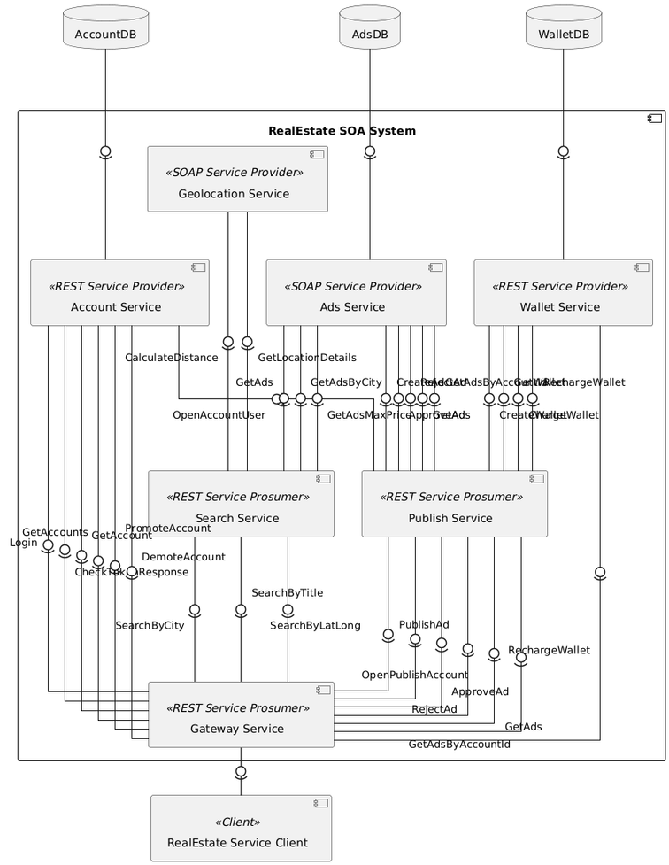
Components
Service Provider
A microservice that exposes functionalities or resources via APIs for other services or clients.
e.g. Ads Service
Service Prosumer
A microservice that both consumes and provides services.
e.g. Search Service

Slide 8
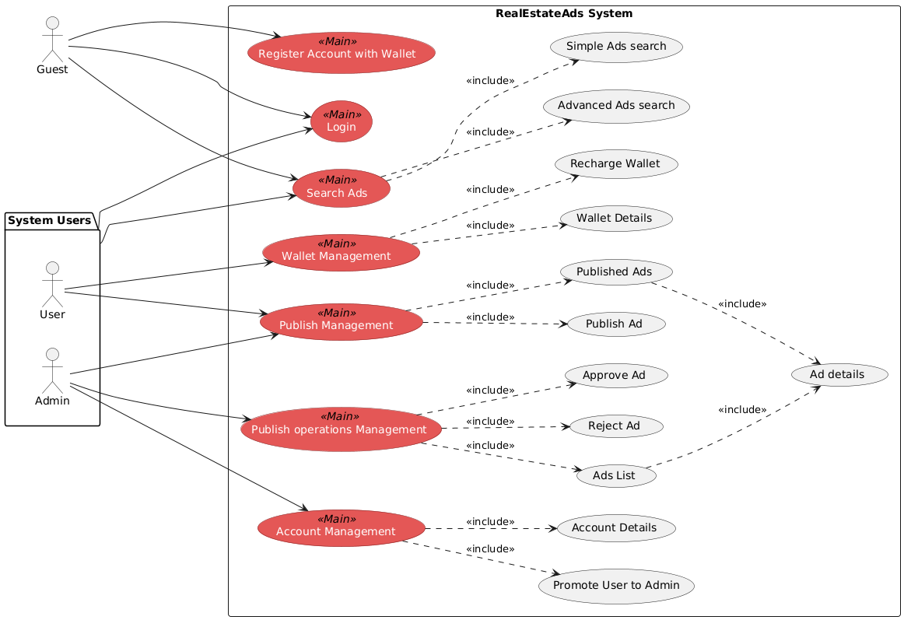
Use Cases

Slide 9
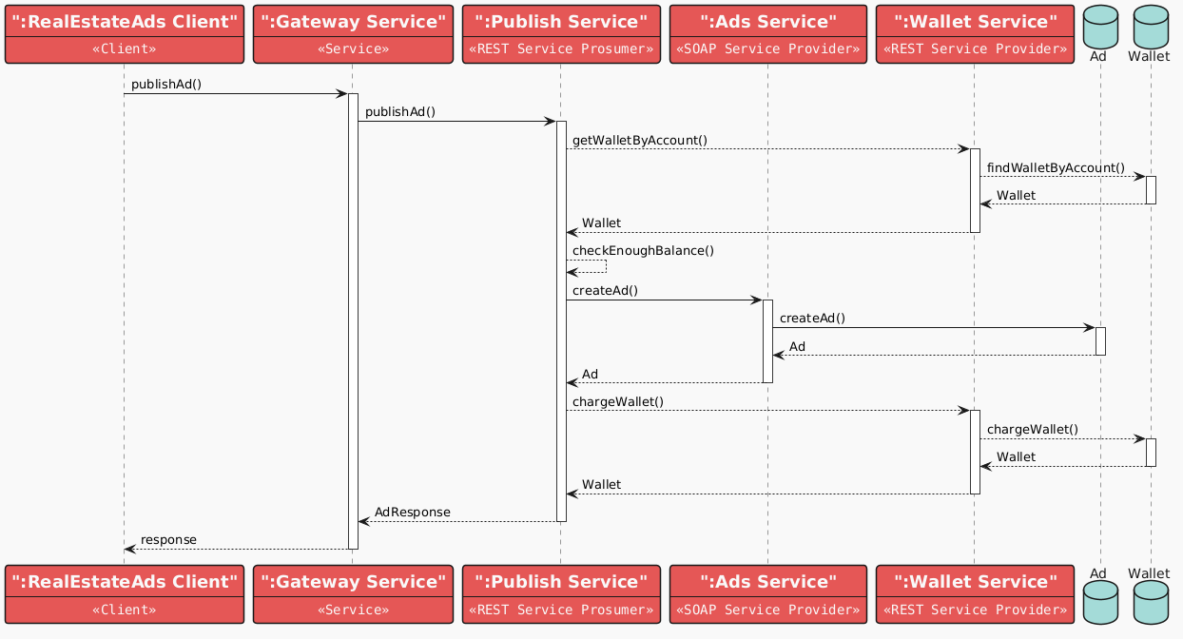
Objective
Scenario Publish Ad
Request for publishing an ad in the RealEstate Ads system. After an asynchronous request, the ad will be in a PENDING_APPROVAL state. Only after approval or rejection by an admin will it transition to either PUBLISHED or REJECTED status, respectively.
Sequence diagram

Slide 10
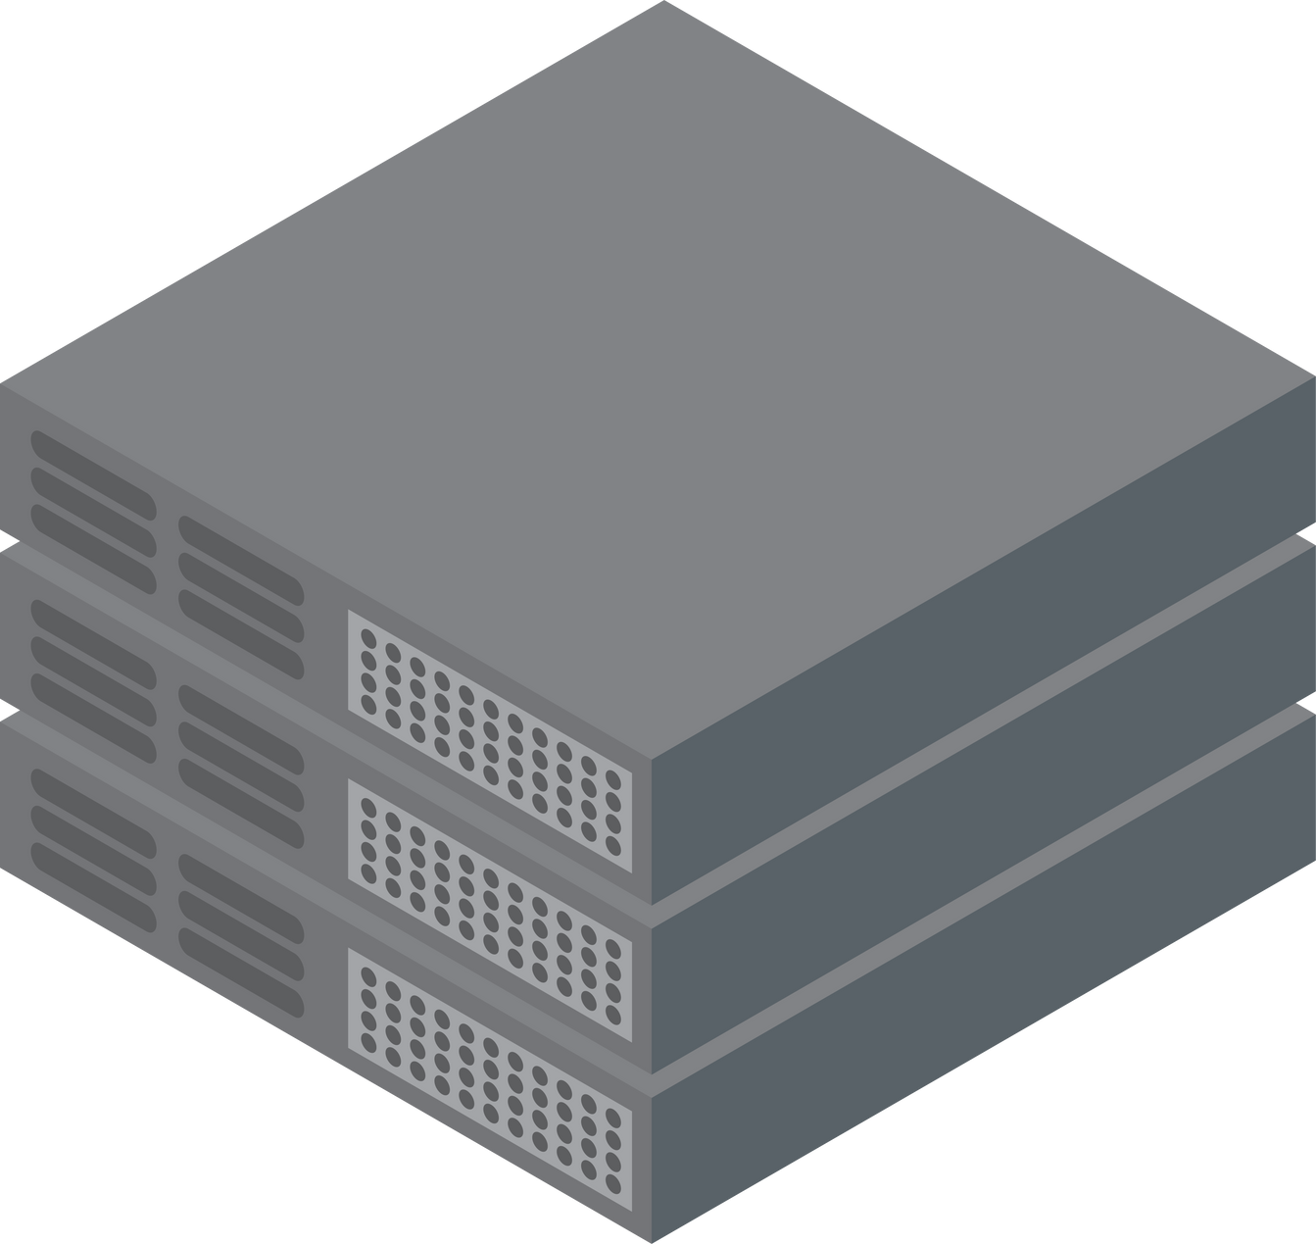

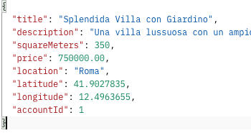
Client-Gateway interaction
Scenario Publish Ad
AdsService SOAP
AdsDB
Client
createNewAd
PublishService REST
Webserver
GATEWAY
url called: http://localhost/api/publish/ad with http method POST
proxy urlStartsWith /api/
urlStartsWith /api/publish route to PublishService
check wallet availability and then charge
WalletDB
WalletService REST

Slide 11
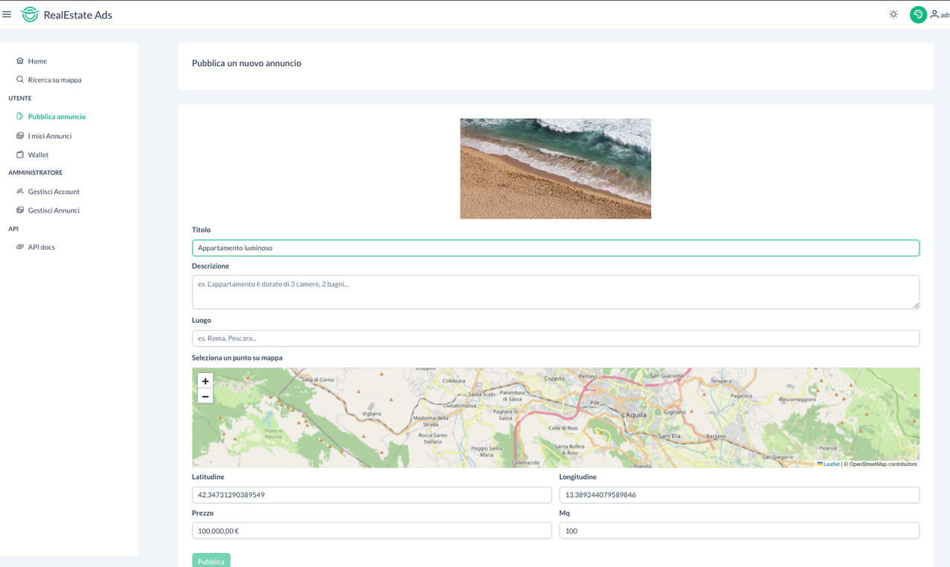
Client UI
Scenario Publish Ad
Through an easy and intuitive UI, powered by Angular and PrimeNG UI, the user enters the necessary informations for the publication request and clicks the Publish button to start the ad publication process.

Slide 12
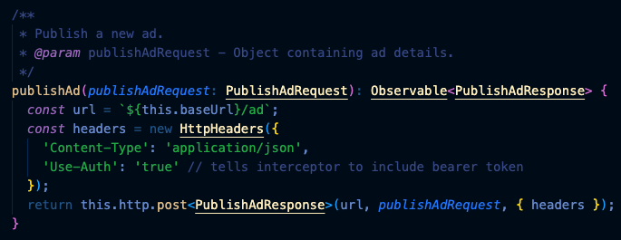
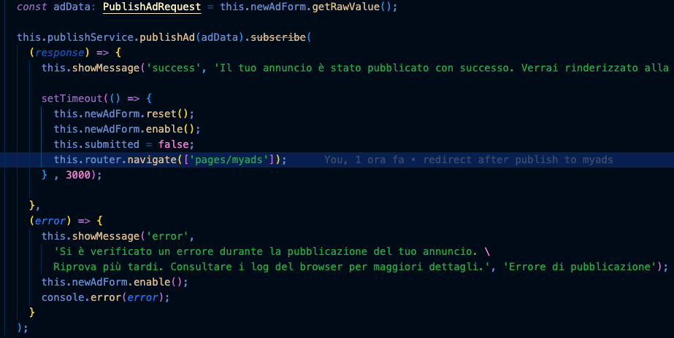
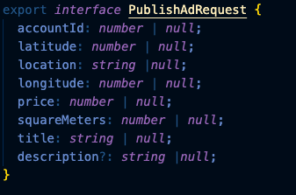
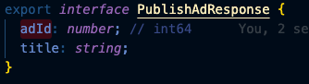
Client implementation
Scenario Publish Ad
Through an easy and intuitive UI, the user enters the necessary information for the publication request and clicks the Publish button to start the ad publication process.
2 - service method
1 - component button handler
url called: http://localhost/api/publish/ad with http method POST
3 - method request object
4 - method response object

Slide 13
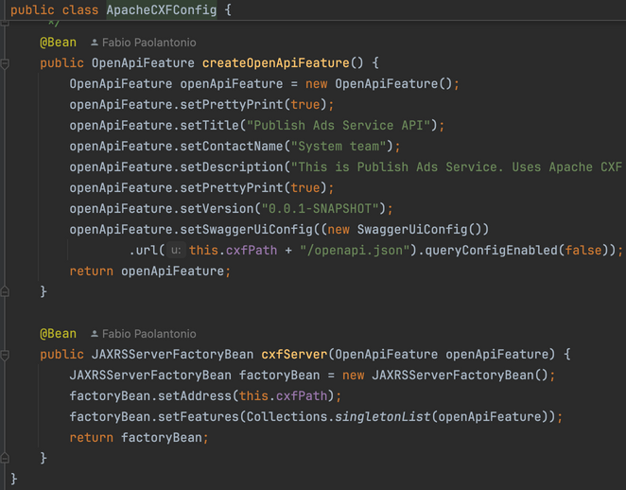
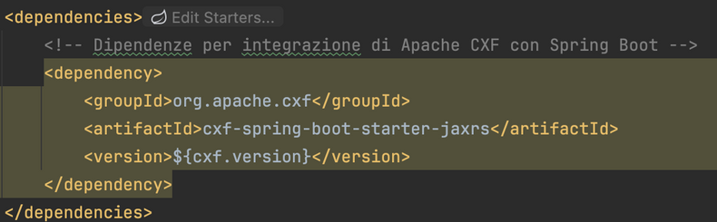
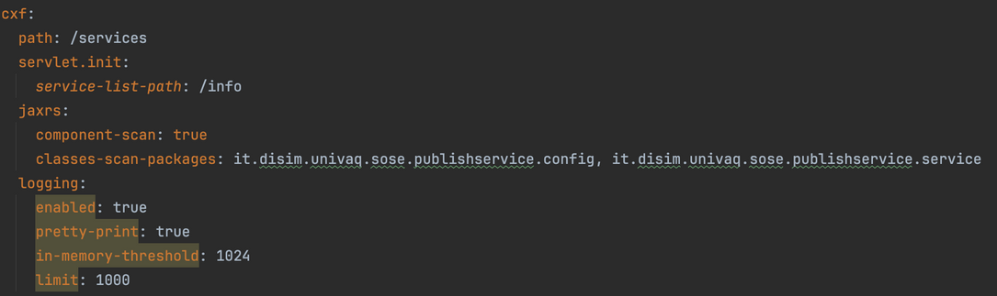
PublishService REST Prosumer configuration
Scenario Publish Ad
The REST Prosumer runs in a Docker container based on Spring Boot, integrated with Apache CXF JAX-RS. It is documented with OpenAPI and Swagger. With the help of AdsService and WalletService, it asynchronously generates a response to the PublishAd request.
2 - ApacheCXF configuration via @configuration Spring annotation
1 - pom.xml cxf-spring-boot-starter-jaxrs: Configures and runs Apache CXF in a Spring application, integrating the necessary dependencies for running Apache CXF in REST mode (JAX-RS).
3 - application.yml To create a REST application, you can use Spring's component-scan to find all the classes needed by Apache CXF and Spring to properly configure the service.

Slide 14
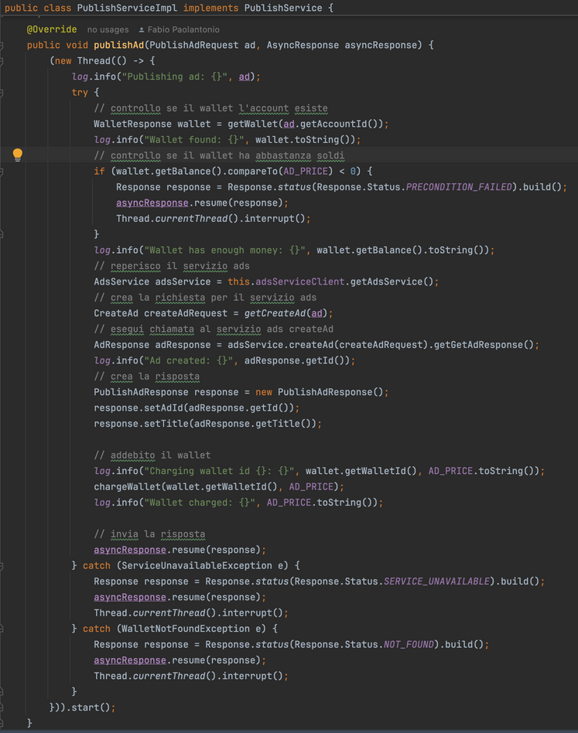
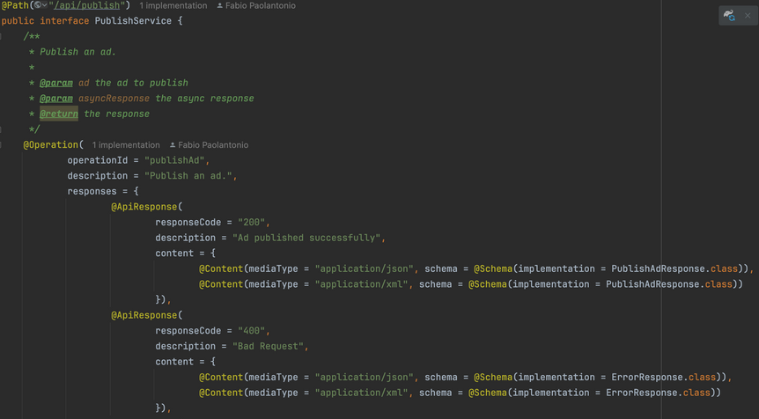
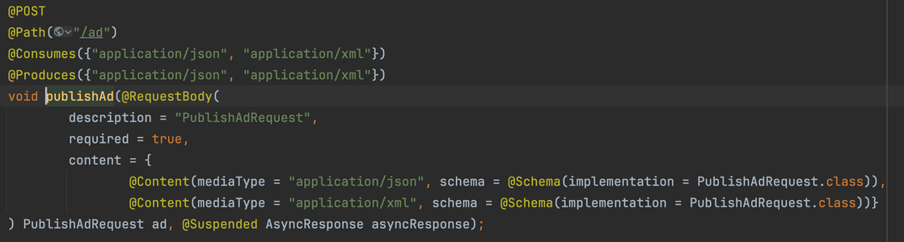
PublishService REST Prosumer implementation
Scenario Publish Ad
The REST Prosumer runs in a Docker container based on Spring Boot, integrated with Apache CXF JAX-RS. It is documented with OpenAPI and Swagger. With the help of AdsService and WalletService, it asynchronously generates a response to the PublishAd request.
2 -Service method implementation
In a separate thread, the WalletService client checks the wallet balance of the user's account before proceeding to call the AdsService client to create the ad. After creating the ad, it charges the wallet with the fixed price fee.
After these operations, it creates a PublishAdResponse, populates it, and sets it into the asyncResponse through the resume method.
1 - Service interface annotations
@ApiResponse with @Schema PublishAdResponse
@RequestBody with @Schema PublishAdRequest

Slide 15
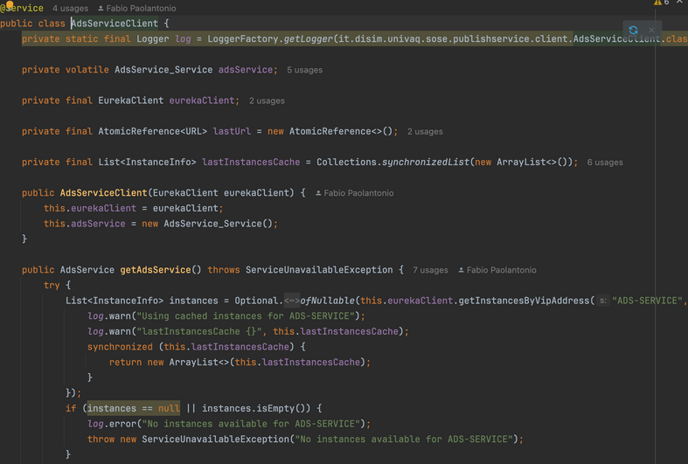
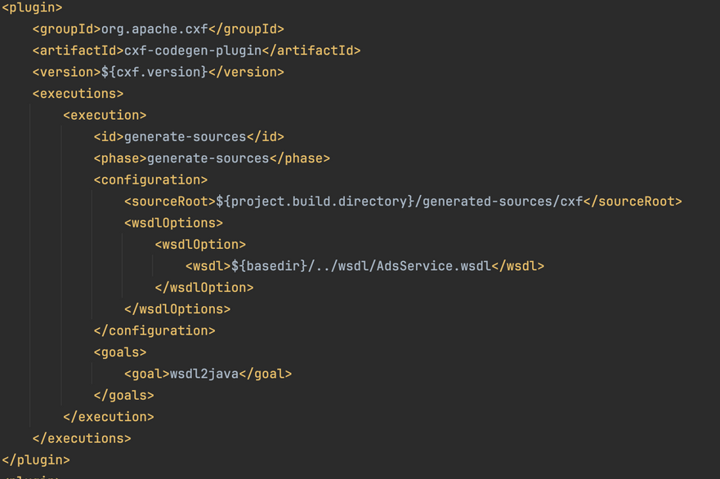
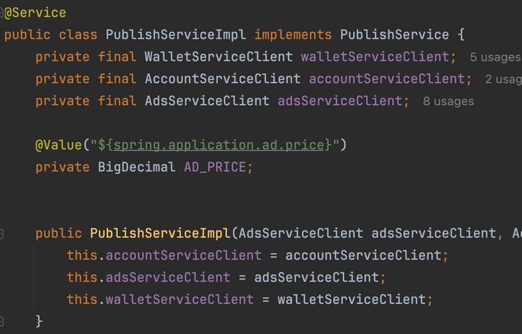
PublishService REST Prosumer
AdsService SOAP Client integration
Scenario Publish Ad
2 - Create Client Service AdsServiceClient the service is retrieved through the discovery service Eureka gives instance available
1 - pom.xml client stub generation
Via Wsdl2java command generates client stub java code from AdsServiceWsdl.wsdl and import code in the project
3 - Inject AdsServiceClient bean in PublishServiceImpl through SpringBoot dependency injection
ready to be used inside the service

Slide 16
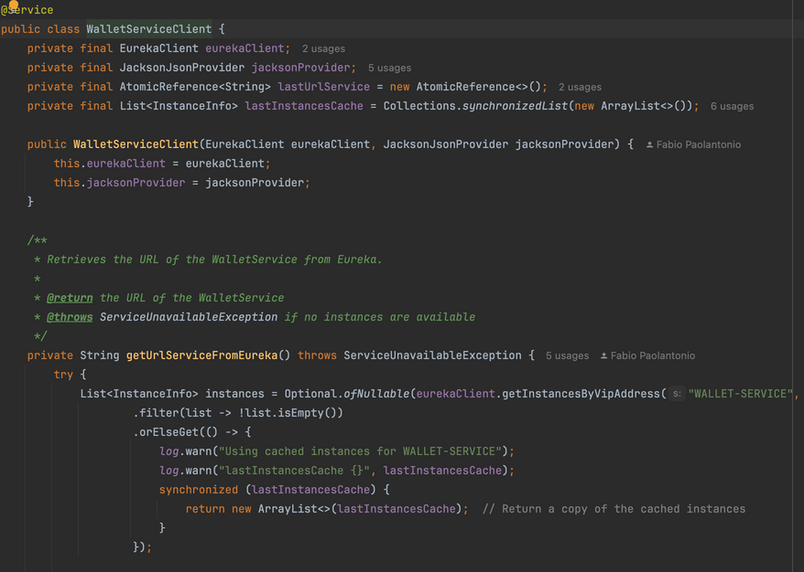
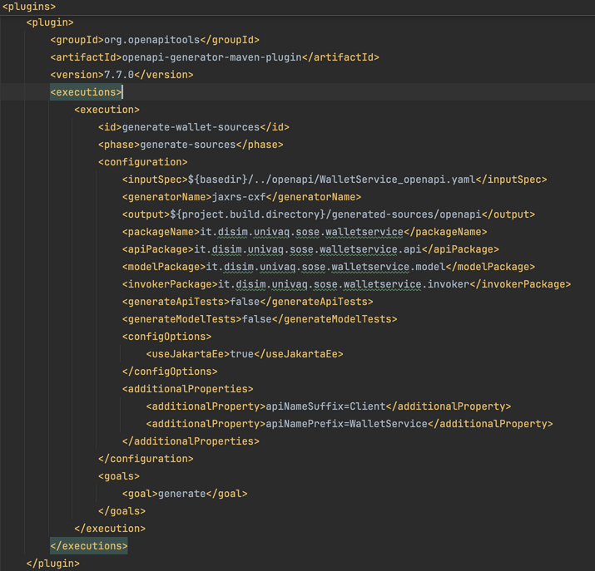
PublishService REST Prosumer
WalletService REST Client integration
Scenario Publish Ad
2 - Create Client Service WalletServiceClient
the service is retrieved through the discovery service Eureka gives instance available
1 - pom.xml client stub generation
Via openapi-generator-maven-plugin generates client stub java code from WalletService_openapi.yaml and import code in the project
3 - Inject WalletServiceClient bean in PublishServiceImpl through SpringBoot dependency injection ready to be used inside the service

Slide 17
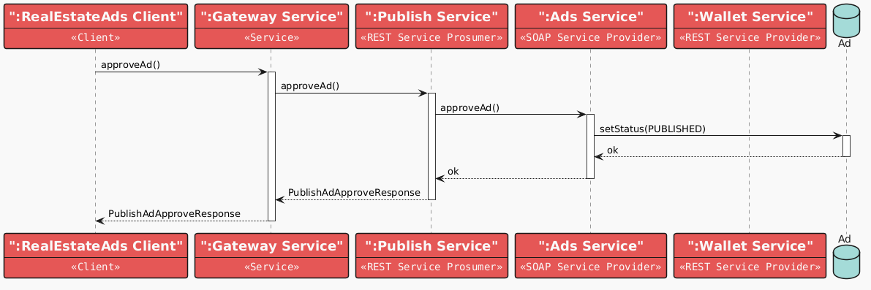
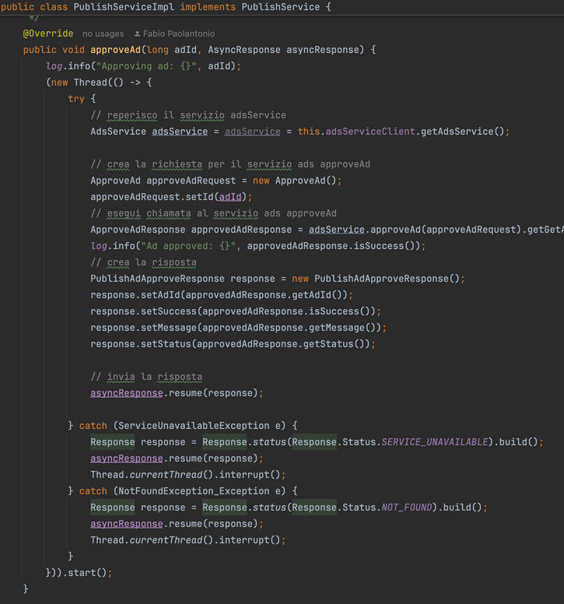
Obiettivo
Scenario Approve Ad
L’utente con ruolo ADMIN approva un annuncio in uno stato PENDING_APPROVAL
Sequence diagram
ApproveAd method in PublishService implementation class

Slide 18
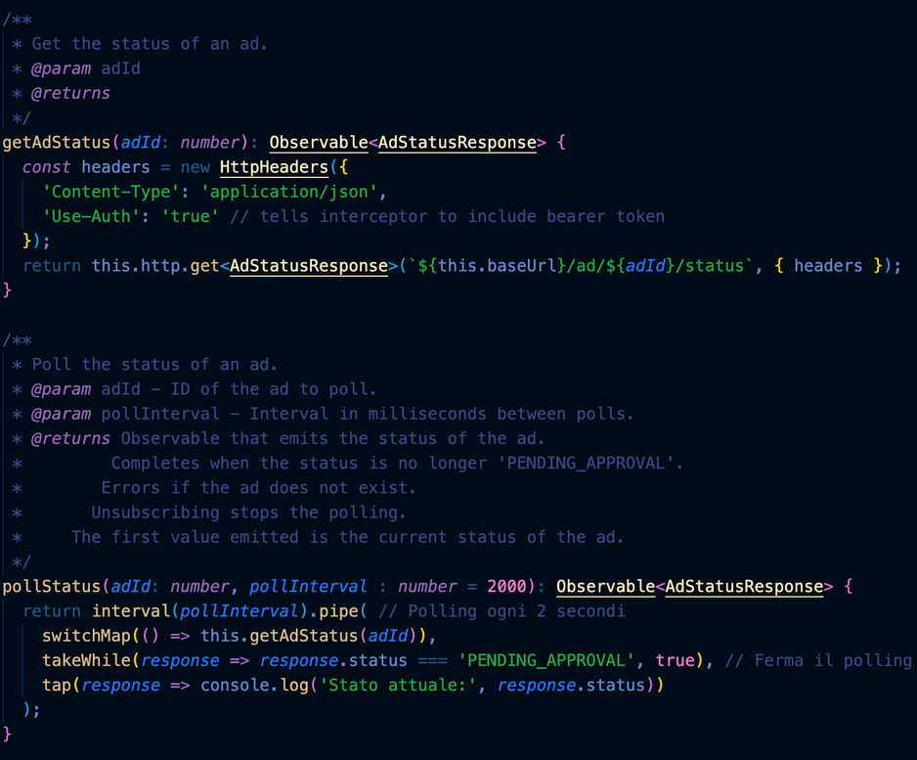
Client polling after ADMIN has approved
Scenario Publish Ad
Page displaying listing of user Ads continously request status of each PENDING_APPROVAL ads and automatically update status to PUBLISHED or REJECTED without refresh the page or any other action on the page DOM
Every 5 seconds client polling checkAdStatus
It is possible thanks to the method pollStatus defined in Client PublishService
url called: http://localhost/api/publish/ad/${adId}/status
with http method GET

Slide 19
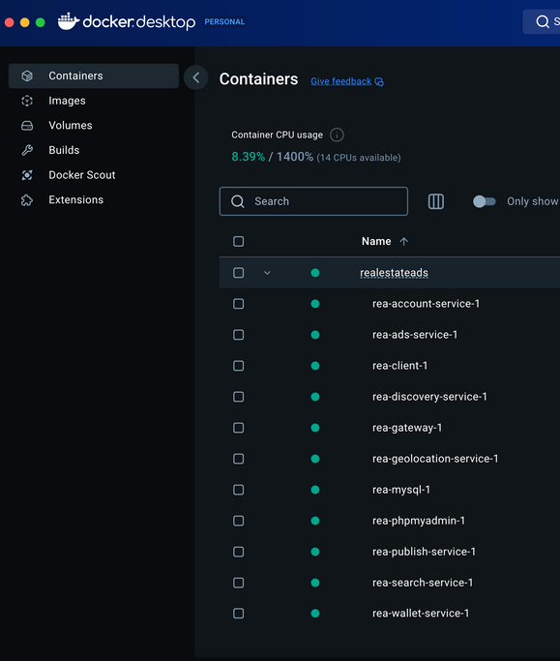
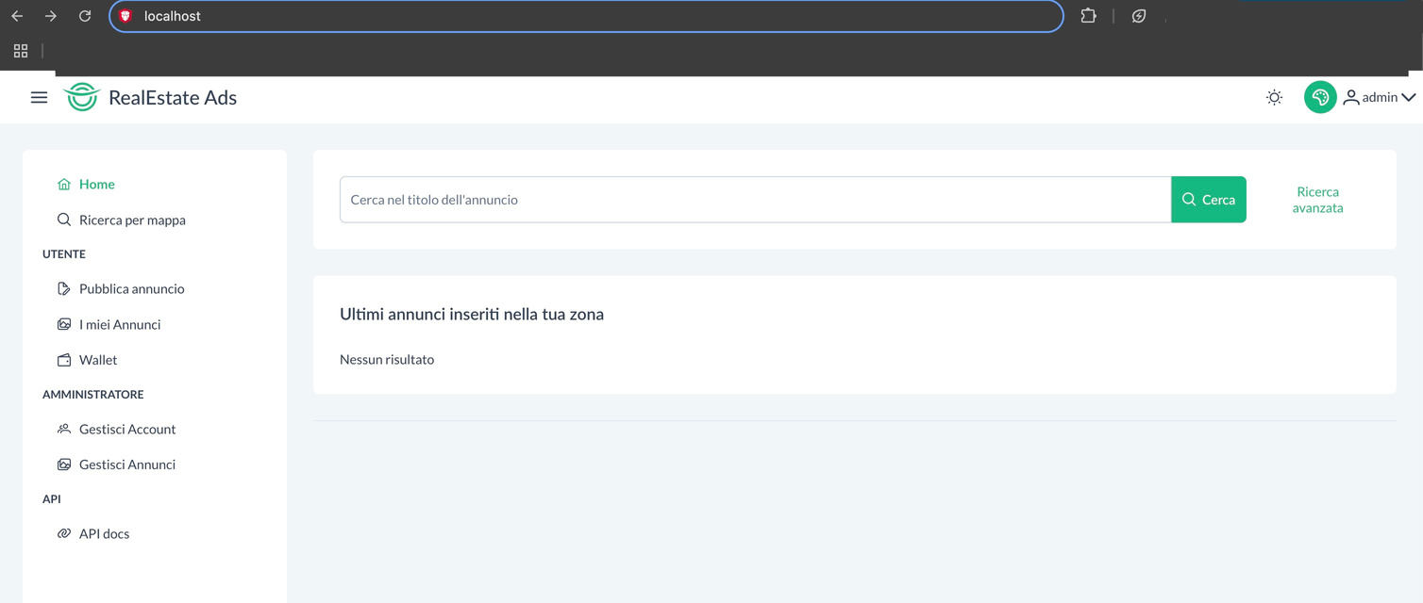
Getting started
Clone the project
REQUIREMENTS
git client (https://git-scm.com/downloads)
Docker (https://www.docker.com/)
Web browser (e.g. https://www.google.com/chrome/)
# git clone https://github.com/fpaolant/RealEstateAds.git && cd RealEstateAds
2. Docker compose
# docker compose up
3. Wait building and running...
4. With your browser go to http://localhost

Slide 20
Spring Boot
Resources
https://spring.io/projects/spring-boot
ApacheCXF
https://cxf.apache.org/
OpenApi
https://www.openapis.org/
Swagger
https://swagger.io/specification/
Angular
https://angular.dev/
PrimeNG
https://primeng.org/

Slide 21

Thank you

